Slide 1
IBM Watson Visual Recognition —

Slide 2
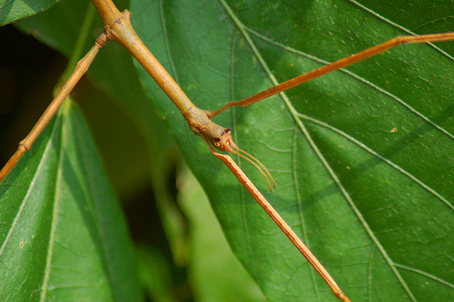

Slide 3
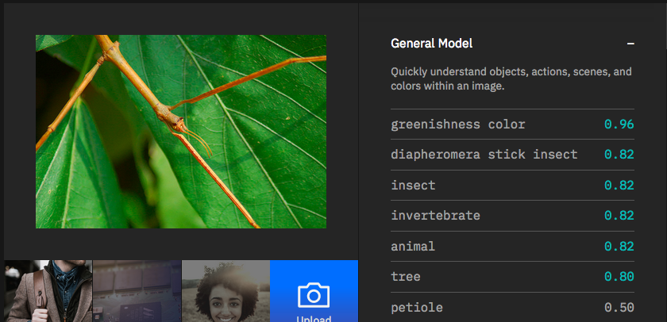

Slide 4
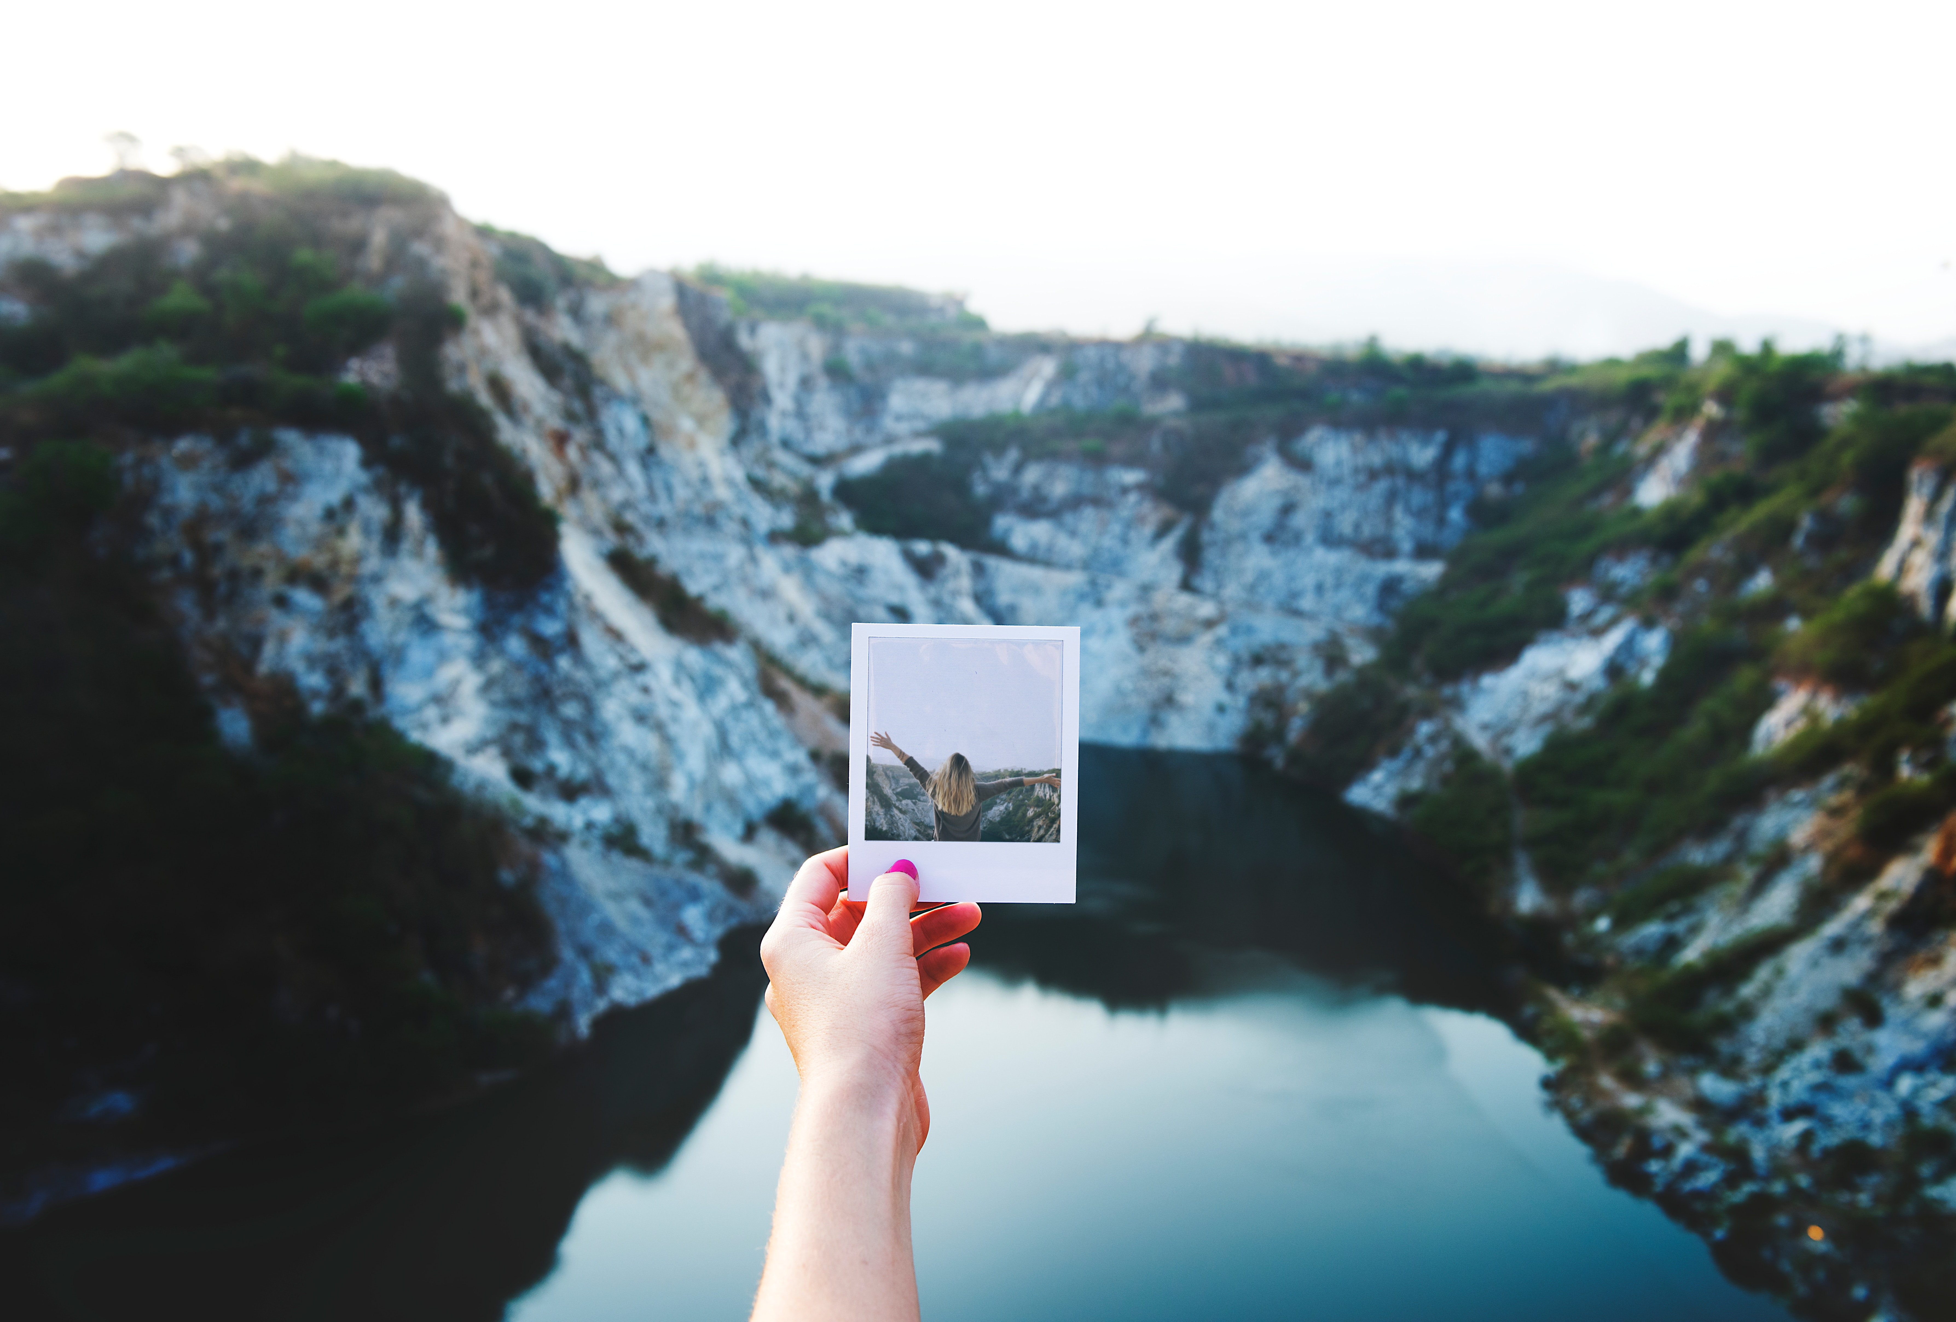
1.2 trillion photos taken in 2017

Slide 5

85 % photos taken using smartphones

Slide 6

Watson Visual Recognition is
An image recognition service that enables users to quickly and accurately tag, classify, and train visual content using machine learning.
BASIL
LEAF
HERB
PLANT STEM
GREEN

Slide 7
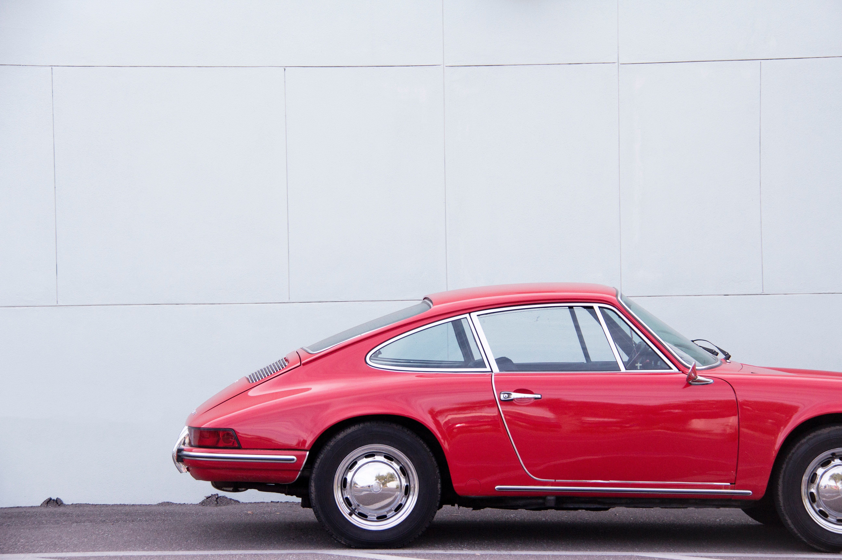
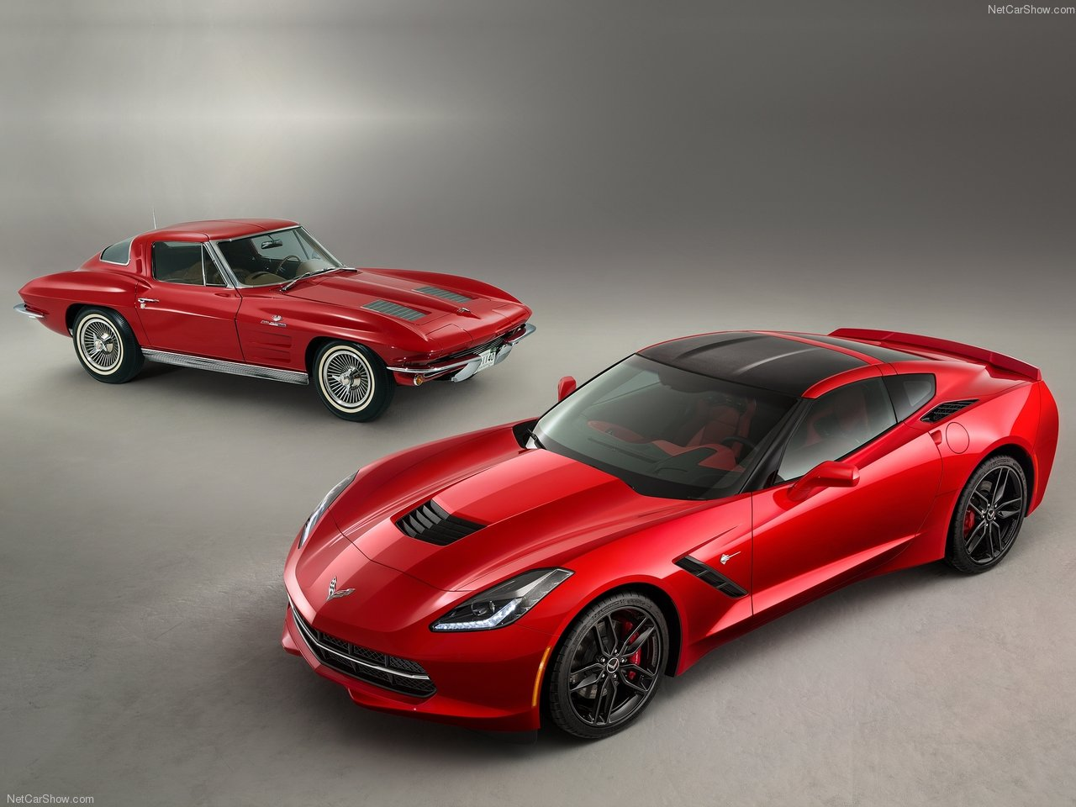
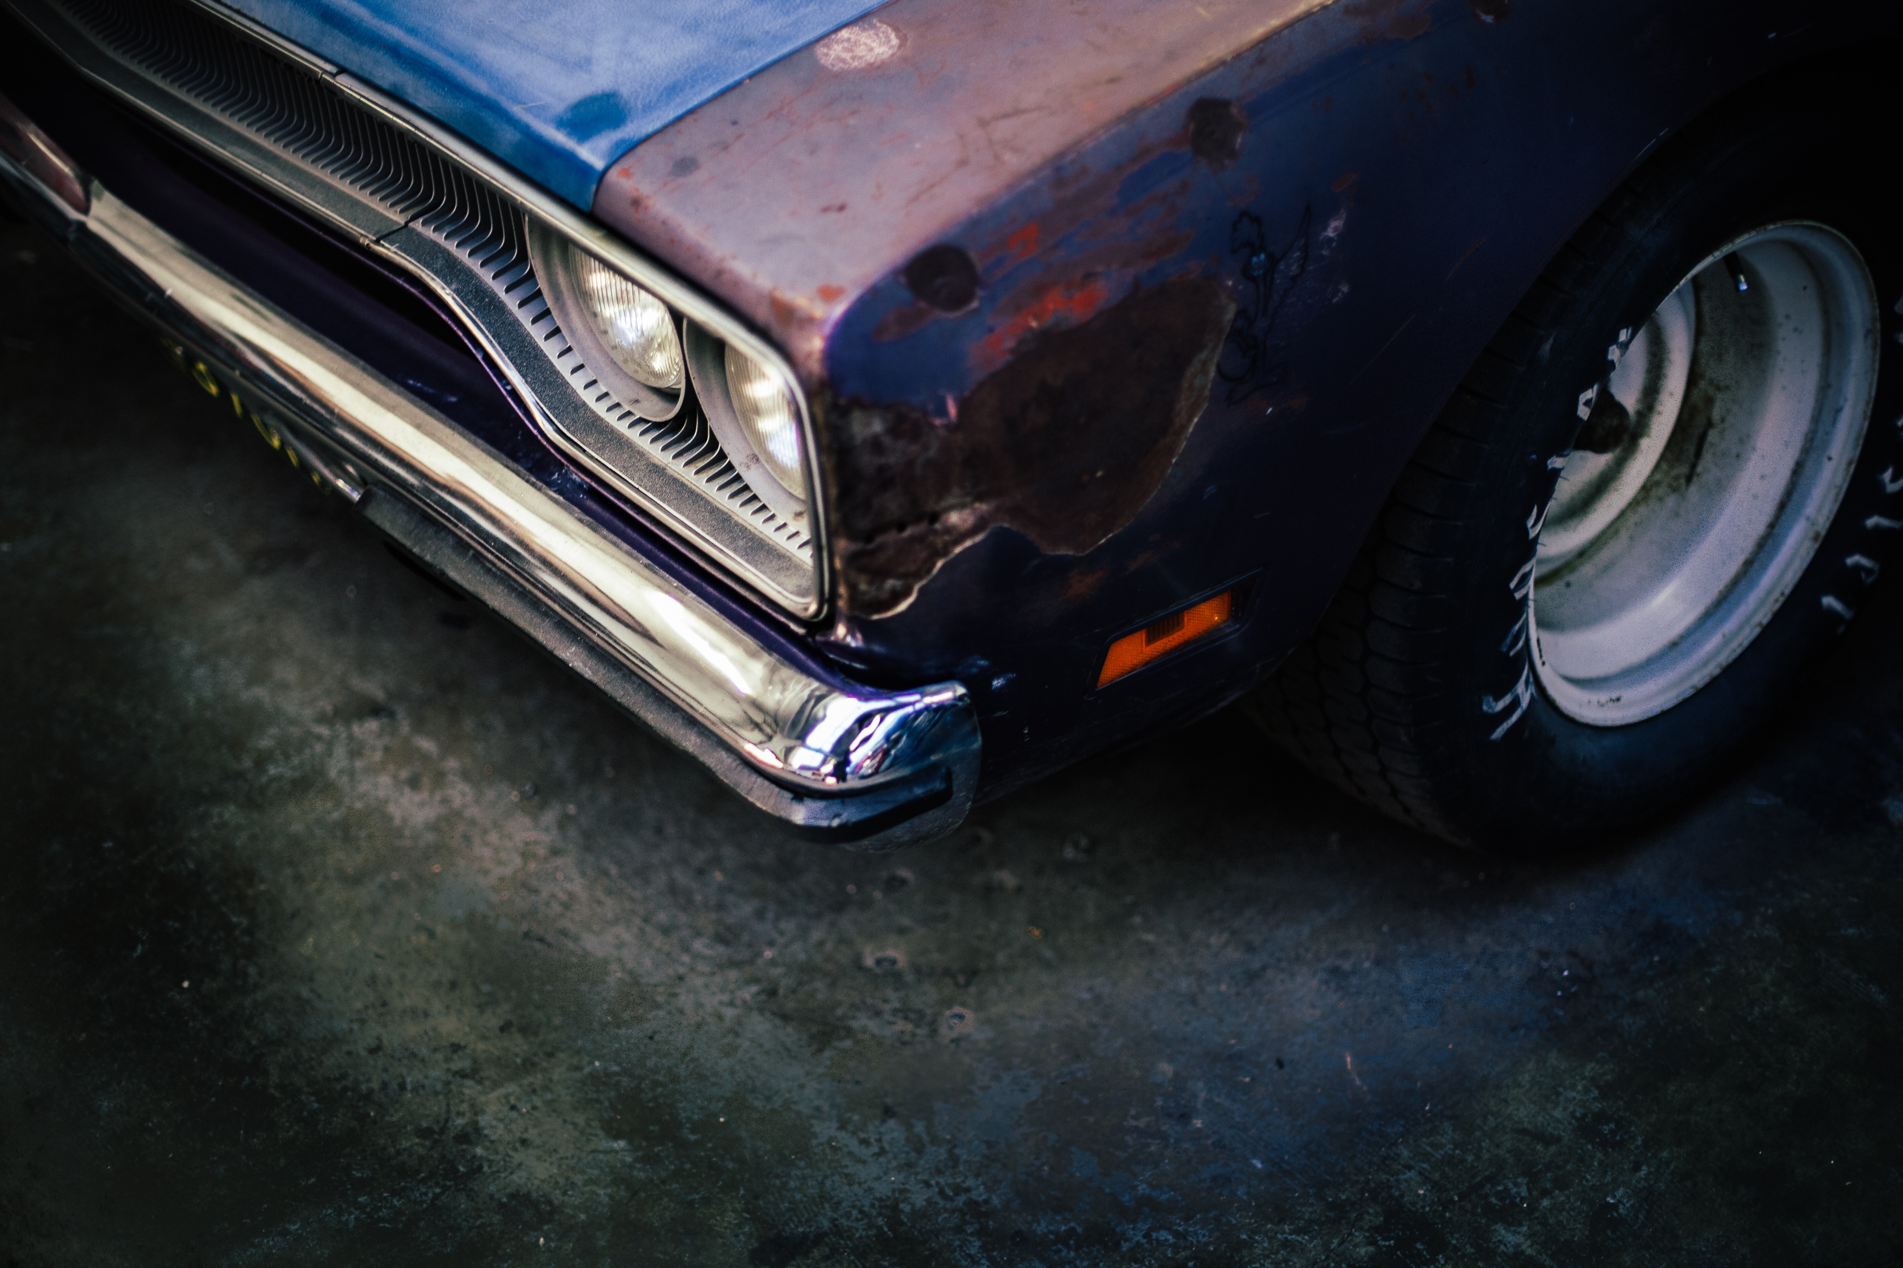
Watson Visual Recognition focuses on
What is Watson Visual Recognition?
Identification
Watson Visual Recognition identifies objects and people.
Categorization
Watson Visual Recognition categorizes for easy organization.
Assessment
Watson Visual Recognition assesses for better problem-solving.
Recommendation
Watson Visual Recognition recommends for faster decision-making.
vintage
hatchback
compact car
vehicle
claret red color
modern
Fender bender, 87% confident
Historically, we’ve paid $7,500 for similar types of damage

Slide 8
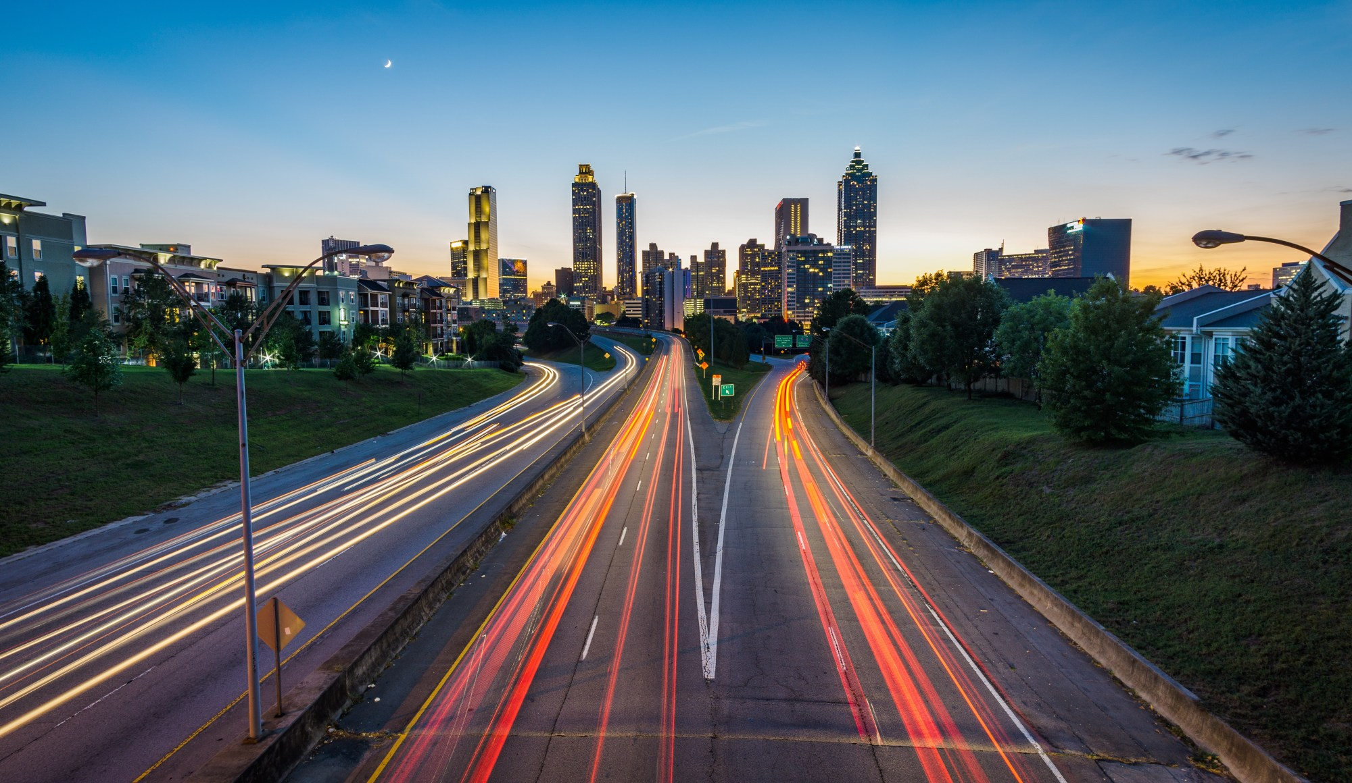
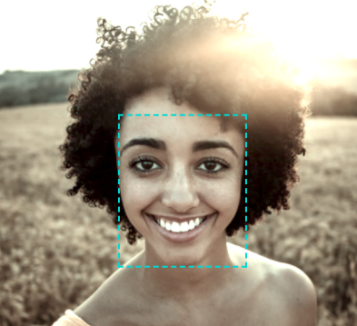
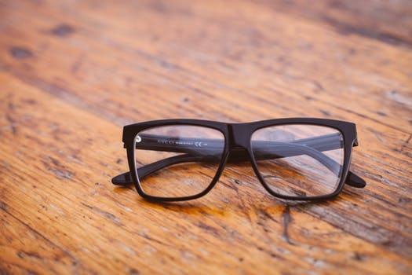
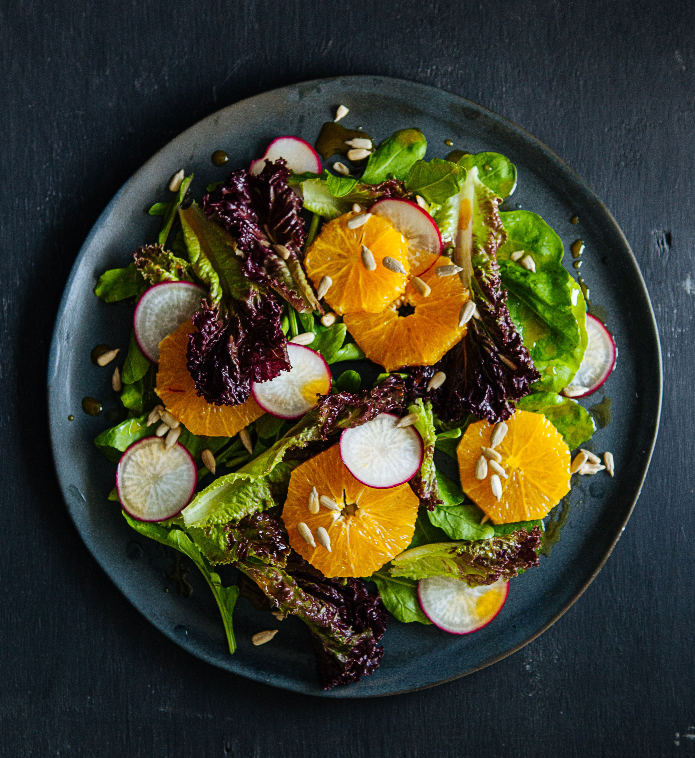
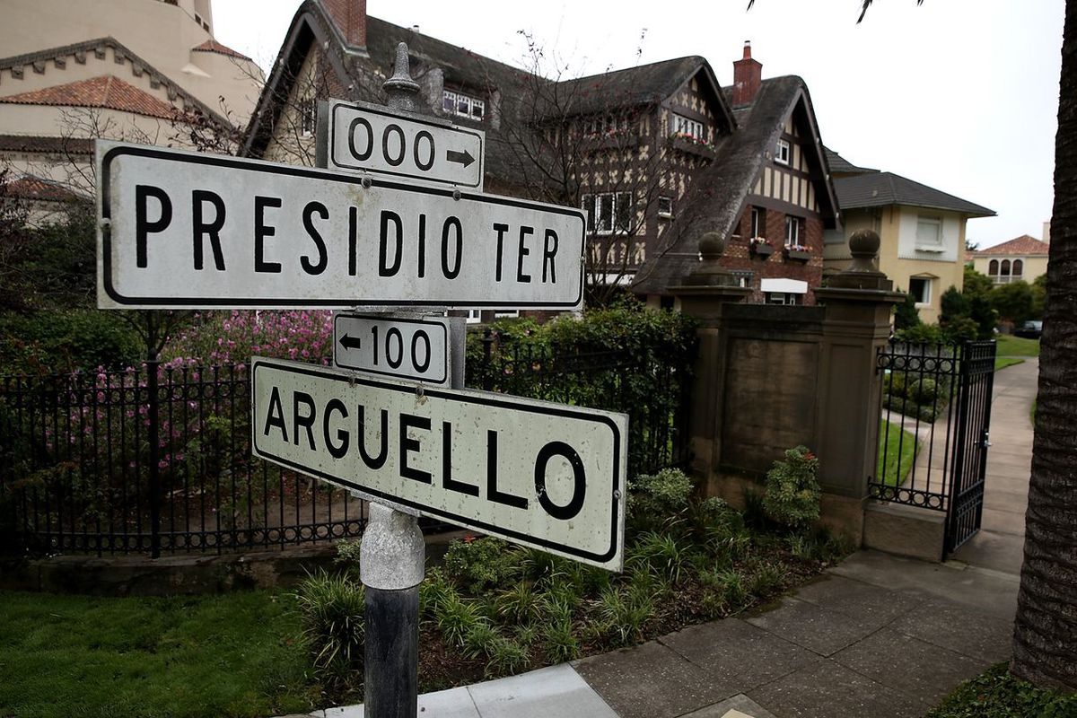
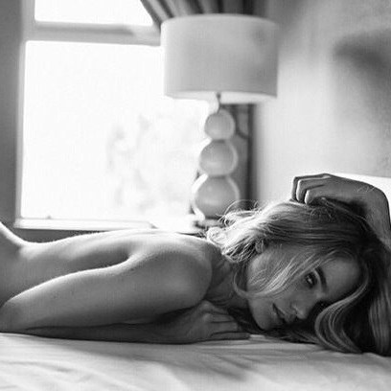
Watson Visual Recognition is trained on
What is Watson Visual Recognition?
Quickly understand the contents, scenes, and actions within an image.
Locate faces within an image and receive age and gender estimates.
Train Watson to understand and classify your own custom content.
General
Faces
Custom
Recognize foods and meals with enhanced accuracy.
Extract full words from natural scene images (i.e. billboards, street signs)
Determine if an image contains inappropriate content that may be unsuitable for general audiences.
Food
Text
Explicit

Slide 9
General classifier categories Animals (including birds, reptiles, amphibians, etc.) Person and people-oriented information and activities Food (including cooked food and beverages) Plants (including trees, shrubs, aquatic plants, vegetables) Sports Nature (including many types of natural formations, geological structures) Transportation (land, water, air) And many more, including furnishings, fruits, musical instruments, tools, colors, gadgets, devices, instruments, weapons, buildings, structures and man-made objects, clothing and garments, and flowers, among others.

Slide 10

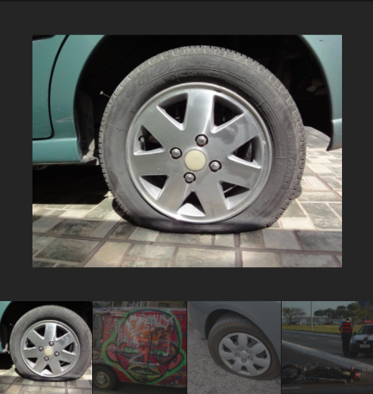
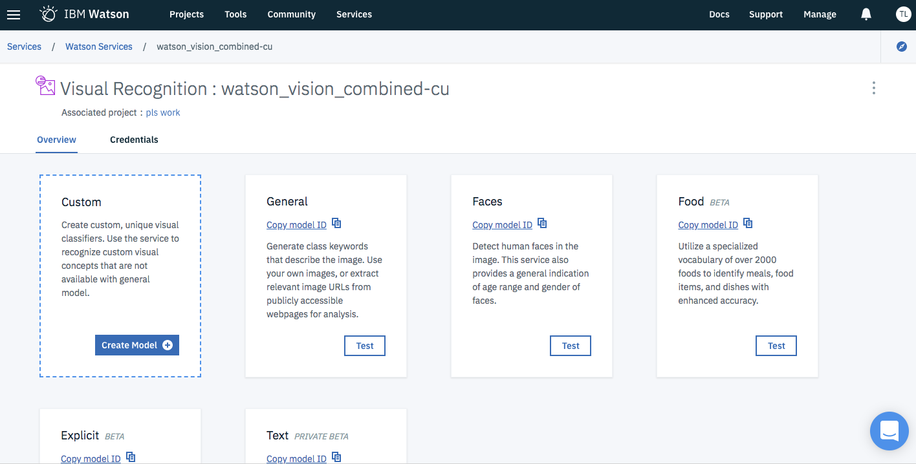
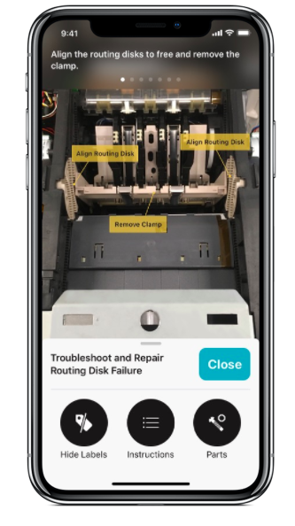
Watson Visual Recognition provides
What is Watson Visual Recognition?
Tooling and API
Accessibility and flexibility
Privacy
and Security
We provide an API to make building apps easy in your preferred language.
Not a developer? No problem! Use our Watson Studio tooling to create, evaluate, and manage your custom models and test our prebuilt one.
Whether you’re looking to get started right away with IBM’s models or custom train your own, we offer options for every user.
You can even build apps that leverage Watson models on iOS devices with Core ML, even when offline.
IBM ensures that images and data passed through our services remain secure. Your data is never used to train IBM models.

Slide 11
Watson Visual Recognition is used for
How is Watson Visual Recognition used?
Visual Inspections
An Insurance company builds an image recognition solution to automate visual inspections for damage, defects, and quality assurance.
Social Media Listening
An Advertising agency analyzes visual content in social media posts to understand content, sentiment, and trends.
Demographics
A Retailer uses face detection capabilities to gather age and gender estimates of its shoppers.

Slide 12
Resource Identification
A Mining & Minerals company uses image recognition to automatically identify assets and sites in satellite imagery.
Content Enrichment
A Media company uses image recognition to automatically append metadata to visual content, turning dark data into searchable content.
Calorie Counting
A Health & Nutrition company automatically identifies foods and meals in order to more quickly return nutrition facts.

Slide 13
INPUT FORMATS *PNG *JPG/JPEG *or .zip file with supported image formats *GIF

Slide 14
WATSON VISUAL RECOGNITION SERVICE INVOCATION API Reference: https://www.ibm.com/watson/developercloud/visual-recognition/api/v3/curl.html?curl Watson SDK: https://github.com/watson-developer-cloud/

Slide 15
BUILD CUSTOM CLASSIFIER USING WATSON VISUAL RECOGNITION

Slide 16
Guidelines for training custom classifier
The service accepts a maximum of 10,000 images or 100 MB per .zip file
The service requires a minimum of 10 images per .zip file.
The service accepts a maximum of 256 MB per training call.
Minimum recommended size of an image is 32X32 pixels.

Slide 17
WALK THROUGH OF WATSON STUDIO TO BUILD CUSTOM CLASSIFIER

Slide 18

Get Started
Visual Recognition: ibm.biz/watsonvisrec Learn more: ibm.biz/visrecresources

Slide 19
BACKUP SLIDES

Slide 20
GDPR Security Migration All IBM Watson™ Visual Recognition service instances created before May 22, 2018 are not suitable for clients that require compliance with the EU General Data Protection Regulation EU 2016/679 (GDPR). Clients that are subject to GDPR need to migrate to a new Visual Recognition service instance available on May 22nd, 2018 and to adopt the new agreement for the Visual Recognition service. Clients will be required to provision a new Visual Recognition service and generate new authentication keys to utilize the new Visual Recognition service. If a client does not provision the new Visual Recognition service, you confirm that IBM is not processing any Personal Data on the client's behalf that is subject to the GDPR. Clients who do not move to the new Visual Recognition service between May 22, 2018 and October 1, 2018 will have their data deleted.

Slide 21
Labelling data If you need to remove an individual customer's data from a Visual Recognition service instance with multiple customers, you first need to associate that data with a unique Customer ID for each individual that may have provided data.

